Slide 1

#FeministFundraiser Quiz

Slide 2
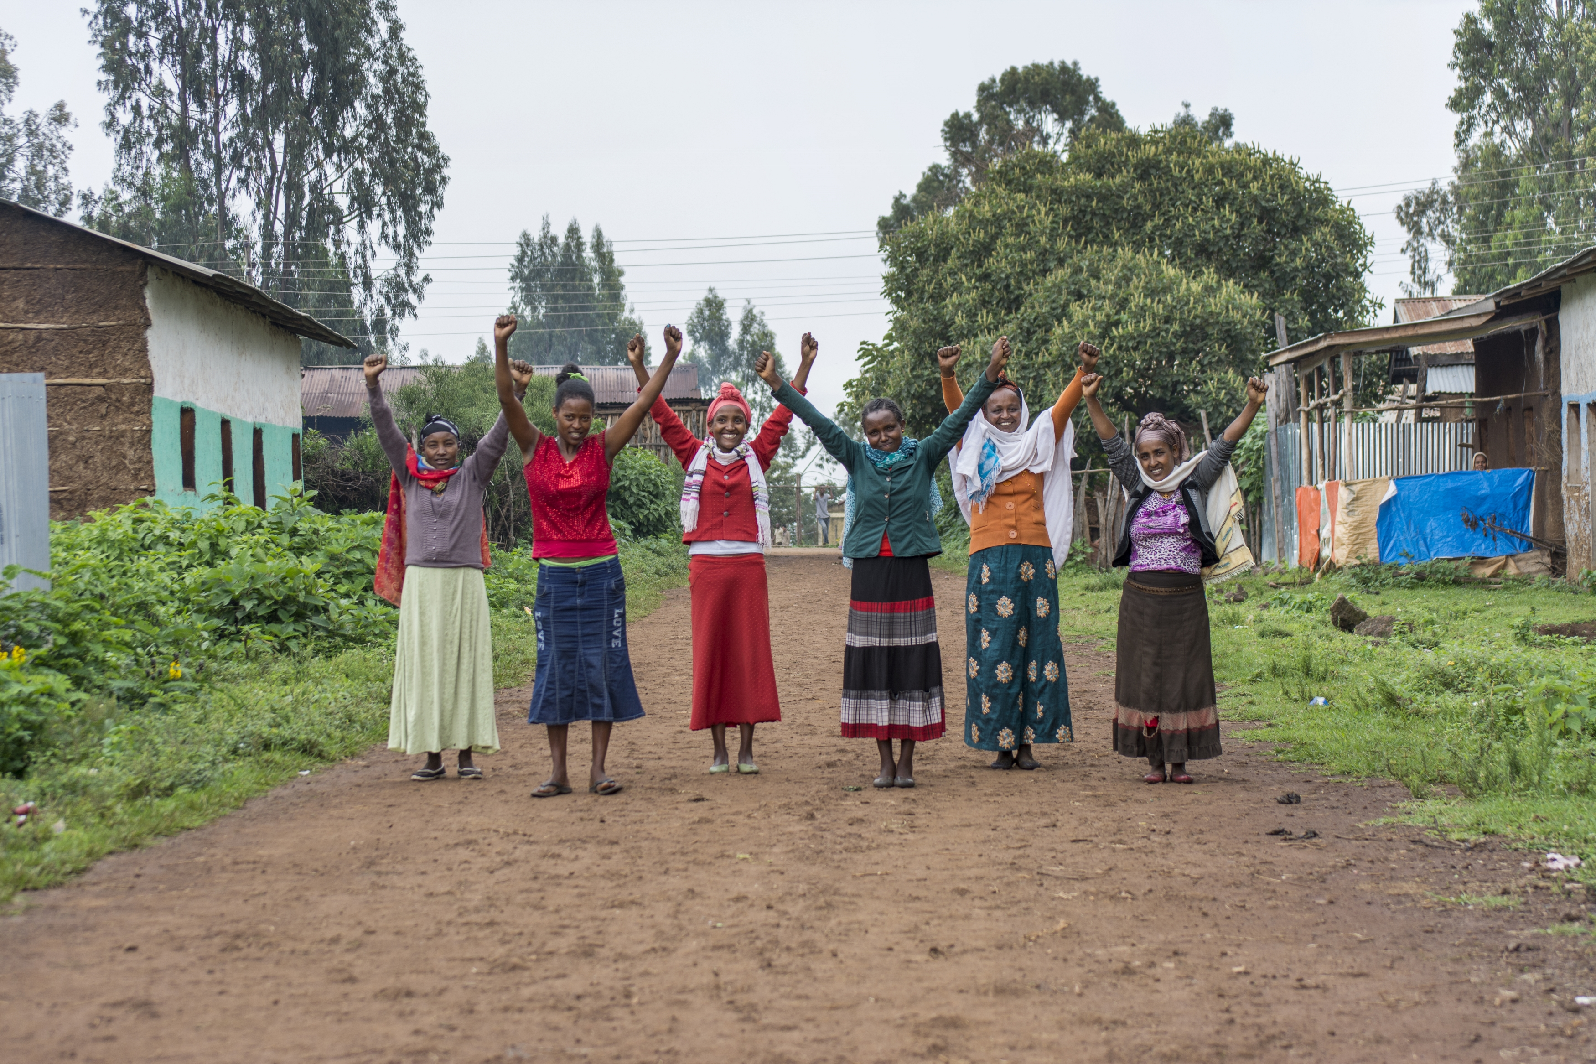
Round 1: | Round 2:
Feminist Trivia! | Get to know us!

Slide 3

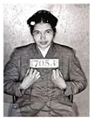



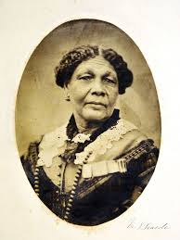
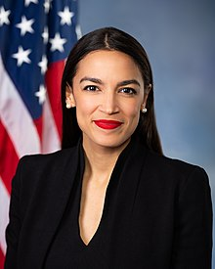
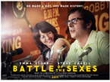
ROUND 1A: Feminist trivia IN PICTURES
Total: /7
1. Which book/TV series? | Answer __/1 | 4. Why was civil rights activist Rosa Parks arrested in 1955? | 4. Answer __/1
2. a) Name this feminist icon b) In which war did she establish the ‘British Hotel’ for sick and wounded soldiers off the battlefield? | 2. Answer __/2 | 5. a) Name this feminist icon b) She is congresswoman for which American political party? | 5. Answer __/2 Video
3. Who does Emma Stone portray in this film? | 3. Answer __/1 Watch me!

Slide 4
ROUND 1b: sports and politics
Total: /6
1. How many gold medals did British Paralympic cyclist and swimmer Sarah Storey DBE win over the course of her Paralympic career? | Answer 6 14 16 __/1
2. The 2018 Winter Olympics had the first female African bobsleigh team. Which country in Africa? | 2. Answer __/1 Video
3. When did Wimbledon introduce equal pay for male and female champions? | 3. Answer 2007 1970 1994 __/1
4. Name one of the co-founders of the Women’s Equality Party. | 4. Answer __/1 Video
5. Which UK General Election saw a record number of women elected into the House of Commons? Note: 220 of 650 MPs were women after this election | 5. Answer 2019 2010 1979 __/1
6. Why did the Suffragettes wear the colours green, white and violet? | 6. Answer They liked them They symbolise hope, purity and loyalty They are gender neutral colours __/1

Slide 5
ROUND 1c: change-makers total: /6
1. Which woman was considered to be the first person to write a computer program? | Answer __/1 Video
2. Who delivered the Ain’t I a Woman speech at the 1851 Women’s Rights Convention in Akron, Ohio? | 2. Answer Zora Neale Hurston Sojourner Truth Maya Angelou __/1 Video
3. Which British actress is credited with starting the #HeforShe campaign? | 3. Answer __/1 Video
4. If two named actresses in a film talk to each other about something other than a man which test is it said to have passed? | 4. Answer __/1
5. What is the title of the 2018 bestseller by award-winning author and journalist, Reni Eddo-Lodge? | 5. Answer __/1
6. Who was the first woman to win a Nobel Prize? | 6. Answer Mother Theresa Alice Munro Marie Curie __/1

Slide 6
ROUND 2: get to know us total: /7
In Womankind’s 30 year history, how many partners have we been privileged to work with? Note: Today, we work with partners across 5 countries: Nepal, Zimbabwe, Ethiopia, Kenya and Uganda. Read more here. | Answer 79 282 155 __/1 Video
2. In Uganda, our partners NAPE and NAWAD* are working to support women who are at risk of eviction from their land and homes by unjust compulsory land acquisition laws. How many women are at risk of eviction over the next six years? | 2. Answer 100,000 1000 1 million __/1
3. The feminist movement in Kenya has a long history and many achievements. What year did the Kenya Constitution set out a legal framework for gender equality and women’s empowerment? | 3. Answer 2010 2017 1981 __/1
4. Approximately how many women and girls alive today have been subjected to Female Genital Mutilation? | 4. Answer 78 million 550,000 200 million __/1
5. a) What year did Ethiopia see its first woman president elected? b) What is her name? | 5. Answer 1998 2014 2018 __/2
6. The generosity of our supporters has a huge impact on the success of our projects! In the year 2020-2021, how many people donated to Womankind Worldwide? | 6. Answer 12,493 10,616 13,279 __/1
Notes:
*National Association of Professional Environmentalists (NAPE)
National Association for Women’s Action in Development (NAWAD)

Slide 7
ROUND 2: get to know us total: /5
1. When was Womankind founded? | Answer __/1
2. 76.5% of workers in Zimbabwe work in informal work*, but this sector is not recognised for its contribution to the economy. In times of economic hardship, as many as ___ jobs are at stake. Our partner, ZCIEA*, are working to protect the rights of workers in the informal sector and to end violence against and harassment of women workers. | 2. Answer 800,000 5.2 million 9.5 million __/1
3. More women are being given access to positions of leadership in their countries and communities across the world. But women’s public and political participation is more than just a numbers game. Our partners are working with women to: | 3. Answer (Choose 2) Create safe spaces to give more women the confidence to speak out and claim their rights Practise speaking in a louder voice Improve the representation of women in leadership within their communities __/2
4. During crises like the COVID-19 pandemic, being able to offer flexible funding to our partners is essential for them to continue their vital work. We have set up a fund to ensure this can happen. The fund is called... | 4. Answer COVID-19 Crisis Fund Resilience Fund Crisis Relief Fund __/1

Slide 8
ROUND 1A:
1) The Handmaid’s Tale
2a) Mary Seacole
2b) The Crimean War
3) Billie Jean King
4) She sat at the front of a bus
5a) Alexandria Ocasio-Cortez (1/2 point for AOC)
5b) The Democratic Party
ROUND 1C:
1) Ada Lovelace
2) b Sojourner Truth
3) Emma Watson
4) Bechdel Test
5) Why I’m No Longer Talking to White People About Race
6) c Marie Curie
ROUND 2A:
1) b 282
2) c 1 million
3) a 2010
4) c 200 million
5a) c 2018
5b) Sahle-Work Zewde
6) a 12,493
ROUND 2B:
On International Women’s Day 1989
2) b 5.2 million
3) a and c
4) b Resilience Fund
Thank you for doing our quiz! To learn more about our partners and their work, visit our website at: https://www.womankind.org.uk/
ROUND 1B:
1) c 16
2) Nigeria
3) a 2007
4) Sandi Toksvig or Catherine Mayer
5) a 2019
6) b They symbolise hope, purity and loyalty
Abbreviations: NAPE National Association of Professional Environmentalists | nawad National Association for Women’s Action in Development | ewdna Ethiopian Women with Disability National Association | ZCIEA Zimbabwe Chamber of Informal Associations | AWSAD Association for Women’s Sanctuary and Development
Informal work refers to professions such as vendors, cross border traders, hairdressers, back yard welders, carpenters, mechanics, tuck shop owners, basic household small scale manufacturers, artisanal miners, flea market traders, fruit and veggies traders, subsistence farmers, and more.

Slide 9
You’ve completed the #FeministFundraiser Quiz!
Thank you for standing alongside us!

